Slide 1
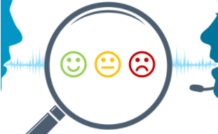

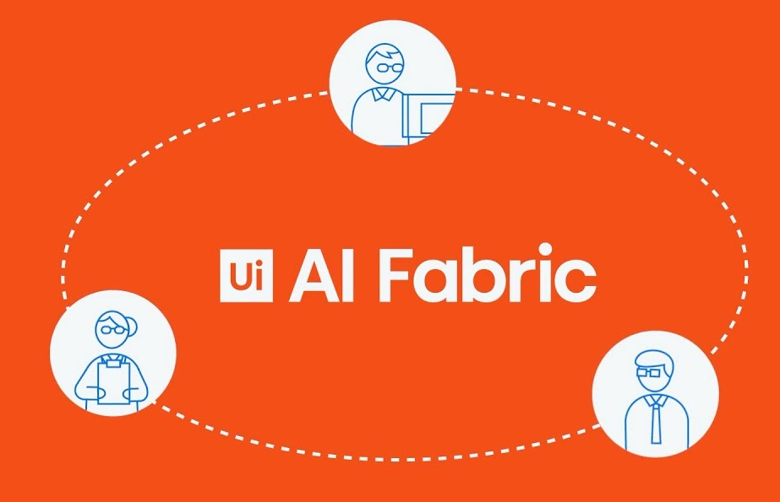
Sentiment analysis on customer feedback emails
Presented by
Ruchi Sinha & Rajashri Gudi
(July 2021)

Slide 2
Sentiment analysis
Sentiment analysis is the interpretation and classification of emotions (positive, negative, and neutral) within text data using text analysis techniques.
Sentiment analysis is a machine learning tool that analyzes texts for polarity, from positive to negative.

Slide 3
Problem Statement
Sentimental Analysis on Customer Feedback Emails
Extract the text from the email contents to get the feedback of the customer
Perform Sentiment Analysis for different mails (Document Understanding – AI Fabric)
Create Dashboard to find out the sentiments, and the trend over the years
Analyse the benefits of automation using RPA tools over human efforts

Slide 4
Test set up
Compare top three RPA Automation Tools – UIPath, Automation Anywhere and Blue Prism for the given problem statement
Scrape the reviews and review date for these 3 tools from www.gartner.com
Send the review data to a test mail id
Review data was scraped using Data Scraping and emails were sent using Email Automation.

Slide 5
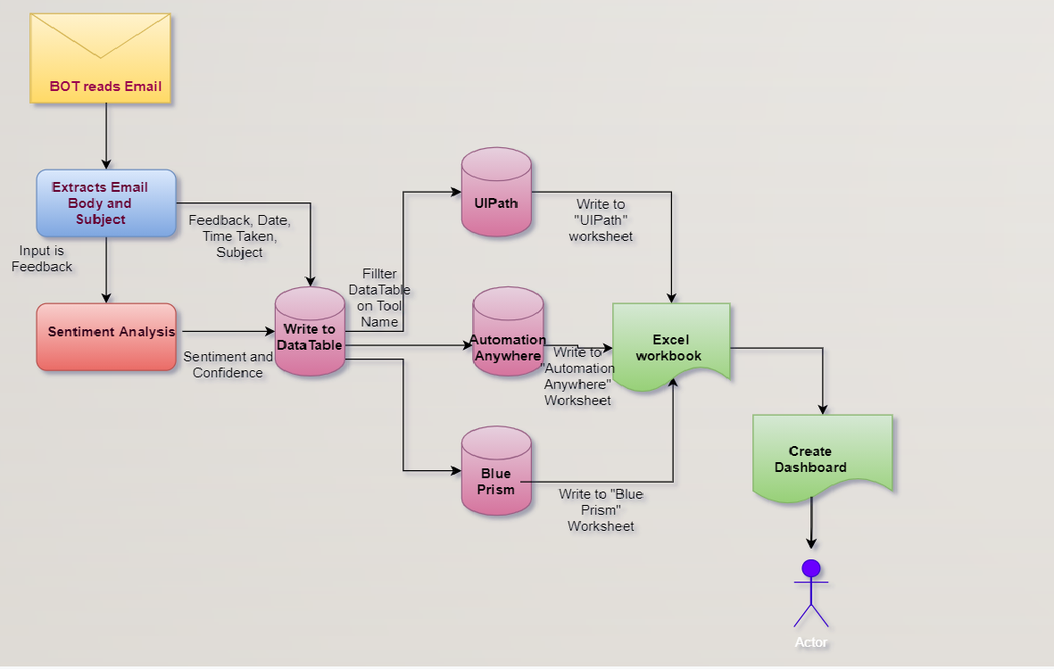
SA Process model

Slide 6





Learnings from the training implemented
Email Automation
Sentiment Analysis Automation using ML Skills
Excel Automation
Scrape the feedback from external website
Bot reads the mails.
Extract the mail contents.
Use the AI centre to analyse the feedback
Store the data in excel, and analyse the data
Web Scraping

Slide 7
SA Process model
Manual
automated
Email is read and processed manually one by one
Dashboard is created manually
Less Effective and less efficient
Takes more time (around 2 minutes for each mail)
Cost is more, and is repetitive and monotonous. Hence prone to errors due to human fatigue
Human emotions are better understood and can be analyzed better
BOT reads Email and feedback is processed using ML Skill
Dashboard creation is automated
Improved Effectiveness and Efficiency
Almost 95% faster execution (based on a data sample of 1500 mails)
Reduces cost.
Need to keep training tool for sarcasm, and other finer language nuances

Slide 8
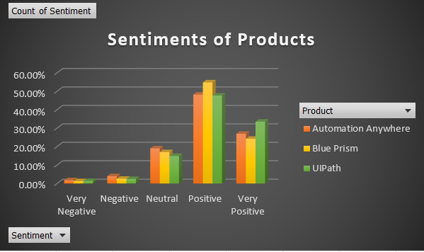
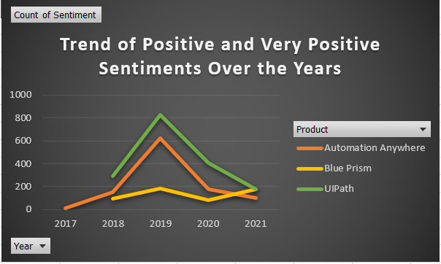
Dashboard

Slide 9
analysis Based on sample feedback
UIPath is relatively newer to the market than Blue Prism and Automation Anywhere
However, today it stands at par with the other tools if not better
The positive and very positive feedback from the last two years for UIPath are much higher than AA and Blue Prism which is encouraging
However the last year has seen a dip, could be because of Covid and market situation. Further analysis needs to be done
Blue Prism is slowly picking up, and UIPath needs to identify additional features that can be provided to meet end user requirements

Slide 10
Learnings and challenges
Sentiment Analysis and Machine Language with its pros and cons is a comparatively new subject in the AI world.
When comparing the SA provided by UIPath with those of Microsoft and Google, UIPath stands close in the race in terms of identifying sarcasm, and overlapping feedback.
Being non-trainable currently, there is a huge market for providing better feedback, as more and more businesses go online.

Slide 11
Future scope of hsi-sentiment analysis project
Evaluate the data further based on certain keywords to identify source of positive/negative feedback.
Feedback is sometimes in the form of non-verbal emojis and expressions. An additional feature can be integrated to handle these scenarios.
Make it as a full plugin to handle feedback for any product, and compare between similar products based on the review comments. Currently we have implemented partial plugin where product names and number of products to compare can be input in the Config file. But this is currently limited to RPA Automation Tools.

Slide 12
Github link and References
rgudi2021/hsirpabatch9-1: HSI Project Group 1 - Sentiment Analysis (github.com)
https://community.uipath.com/events/details/uipath-mumbai-presents-episode-3-uipath-ai-fabric-sentiment-analysis-model/
Demo | AI Fabric Sentiment Analysis | Feedback | UiPath |OOTB Models | Machine Learning | RPA – YouTube
How to use AI Center in UiPath ? | Demonstration of AI Center UiPath | Sentiment analysis | Nisarg - YouTube

Slide 13
Questions?

